Slide 1

Part 1: Python basic

Slide 2
CONTENTS
2
Part 1: Python basics
Getting Started with Jupyter Notebook
Variables and simple data types
Introducing lists, Tuples, Sets and Dictionaries
Conditional Statements and While loop
Function and class (OPP)

Slide 3
Outline
3
1. Getting Started with Jupyter Notebook
Installing Anaconda and Python
What Is Jupyter Notebook?
Open Jupyter Notebook
Running a Python Program
Practice

Slide 4
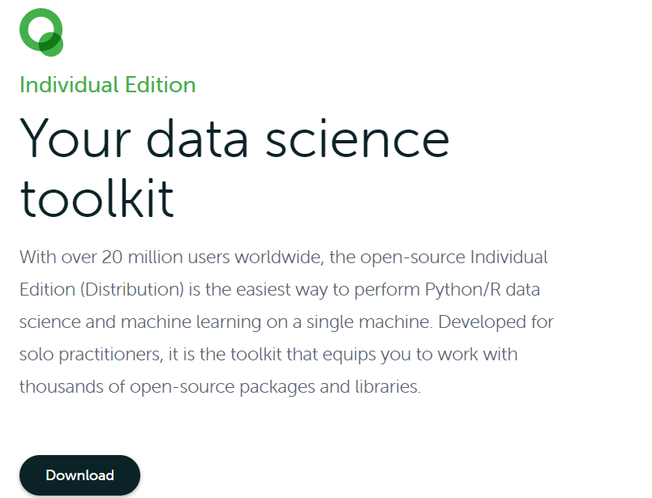
Installing Anaconda and Python
4
1. Open your browser and type www.anaconda.com/products/individual
2. Click the download button

Slide 5
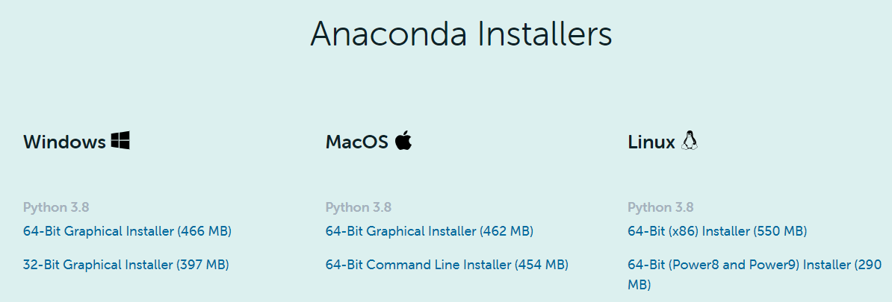
Installing Anaconda and Python
5
3. Click download for Python 3.8 (or later)

Slide 6
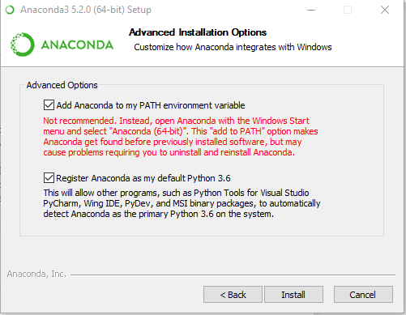
Installing Anaconda and Python
6
4. Click “add to path” option

Slide 7
What Is Jupyter Notebook?
7
It is an open-source integrated development environment (IDE) that allows:
Create and share documents that contain live code.
Equations
Visualizations
Narrative text

Slide 8
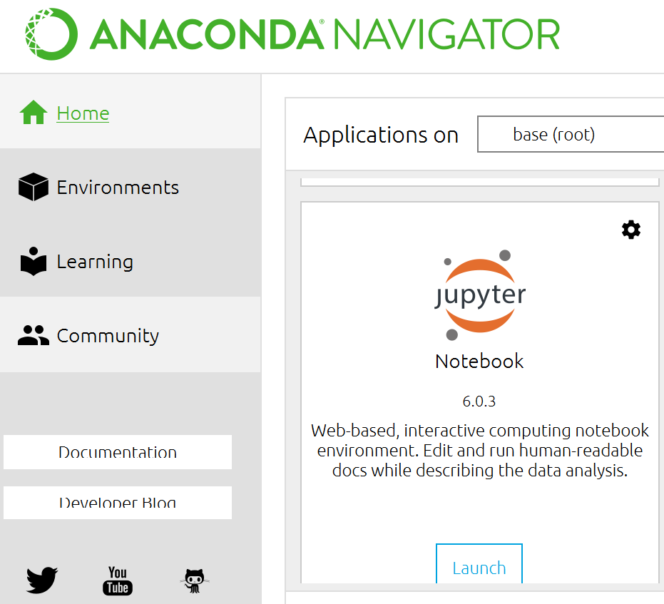
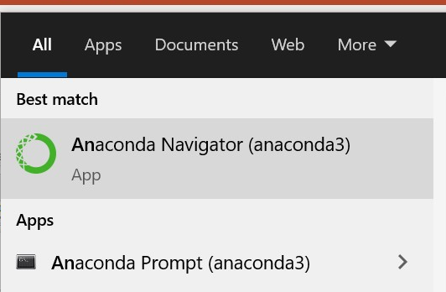
Open Jupyter Notebook
8

Slide 9
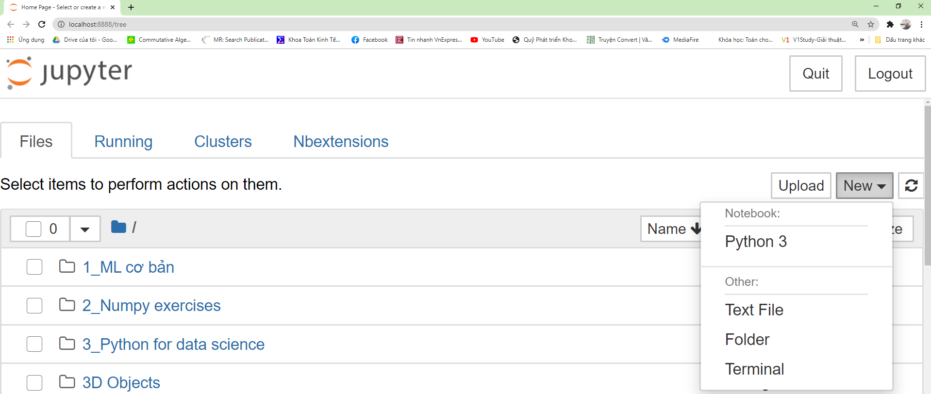
1.1. Getting Started with Jupyter Notebook
9
Open Jupyter Notebook

Slide 10
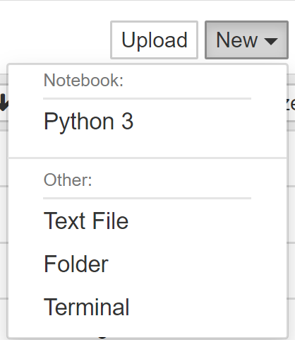
Using Jupyter Notebook
10
Creating Files

Slide 11
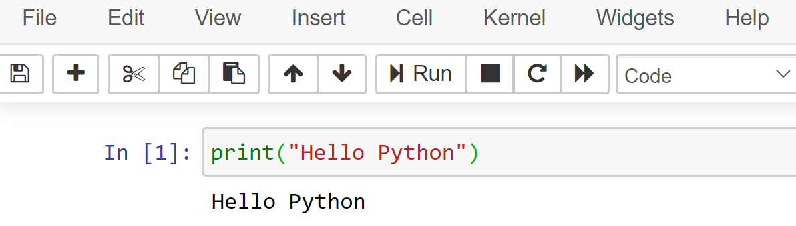
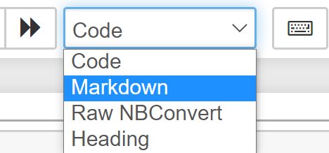
Running a Python Program
Practice with Jupyter Notebook
Create folder and file (python 3)
Comment (#) and Markdown

Slide 12
Practice

